Slide 1
Test Generation from UML Specifications
Michael A. Gray
American University
Washington, DC

Slide 2
Today's Agenda
Review the sources of test generation information available in UML models
Discuss the extraction and use of the UML information
Survey some of the recent efforts in test generation from UML

Slide 3
Preface
Will treat a UML specification as an exact statement of the desired system
Each item of information in the specification is a requirement on the implementation
Programming Language Grammar
UML Specification
Program
Implementation
Program
Implementation
Program
Implementation
Program
Implementation

Slide 4
Preface
The testing in today's discussion is that required to verify the claim that an implementation is a valid instance of the specification
Programming Language Compiler
Testing
Program
Implementation
Program
Implementation
Program
Implementation
Program
Implementation

Slide 5
1. Review
Will consider only the structural and behavioral models of a UML specification
UML models consist of diagrams - graphs of vertices (things) and arcs (relationships)
There are 5 complementary views used in UML to specify OO systems - each view contains structural and behavioral modes

Slide 6
1. Review
We will focus on
the Design View and the Use Case View
These views are assembled using 9 kinds of predefined diagrams
The structural group of diagrams are
the object diagram
the class diagram

Slide 7
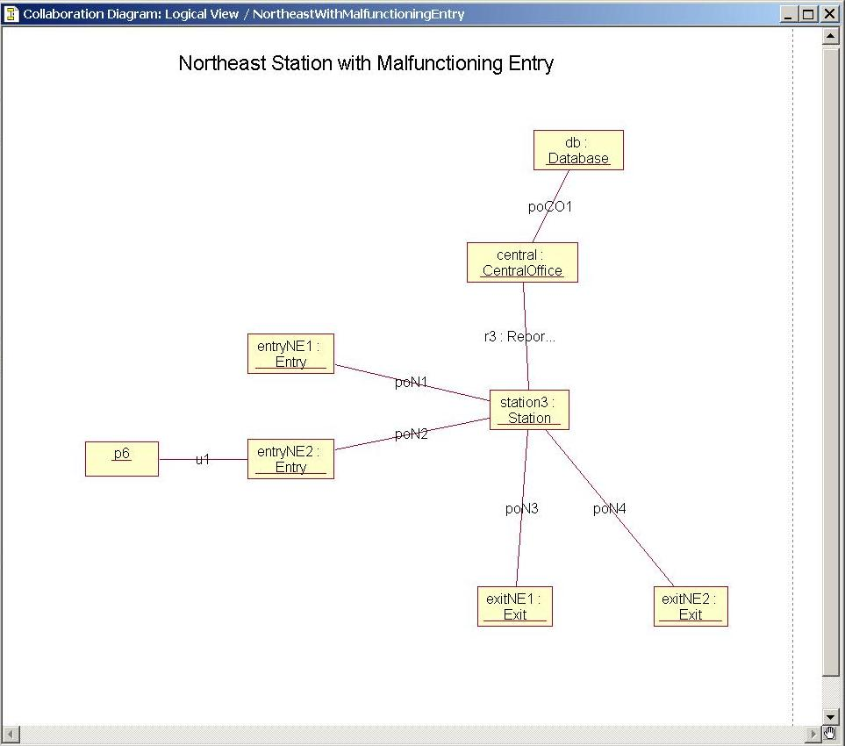
1. Review
the object diagram is a static representation of the system at some point
it contains
  objects
  links

Slide 8
1. Review
the class diagram contains
  classes (instance multiplicity)
  interfaces
  collaborations
  dependency relationships
  class relationships
    Generalization/Specialization (root, leaf properties)
    Aggregation/Composition
    Association (link multiplicity)

Slide 9
1. Review
the class diagram contains
  attributes (concept-specifying and state-specifying)
    type and initial value
    collection multiplicity
    properties (changeable, addOnly, frozen)
  operations
    visibility
    signature
      parameter list (direction name : type = default-value)
      return type
    properties (isQuery, sequential, guarded, concurrent)

Slide 10
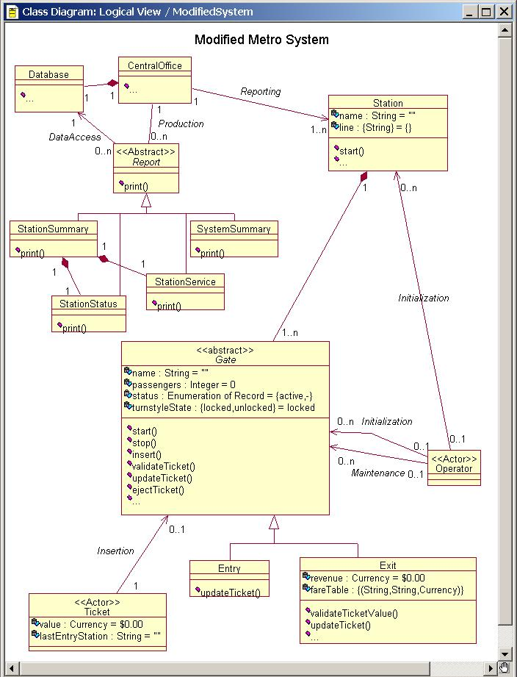
1. Review
example class diagram

Slide 11
1. Review
The behavioral group of diagrams are
the use case diagram
the sequence diagram
the collaboration diagram
the statechart diagram
the activity diagram

Slide 12
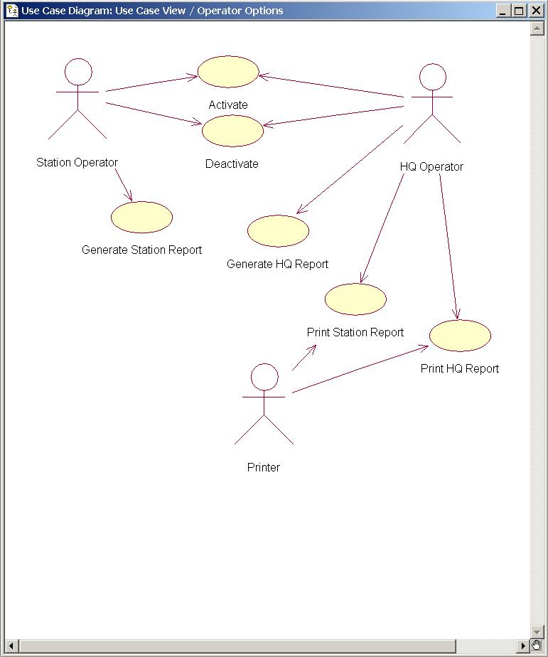
1. Review
the use case diagram
shows a set of use cases and their relationships – specifies the uses view of a system in a case format

Slide 13
1. Review
the use case diagram
  a use case is a functional requirement on sequences of actions that a system performs to yield a result for a user
  each sequence represents the interaction of the external objects with the system
  organization
    generalization/specialization relationships
    dependency relationships (<<extend>>,<<include>>)

Slide 14
1. Review
the scenario
  a specific sequence of actions that illustrate behavior
  instances of use

Slide 15
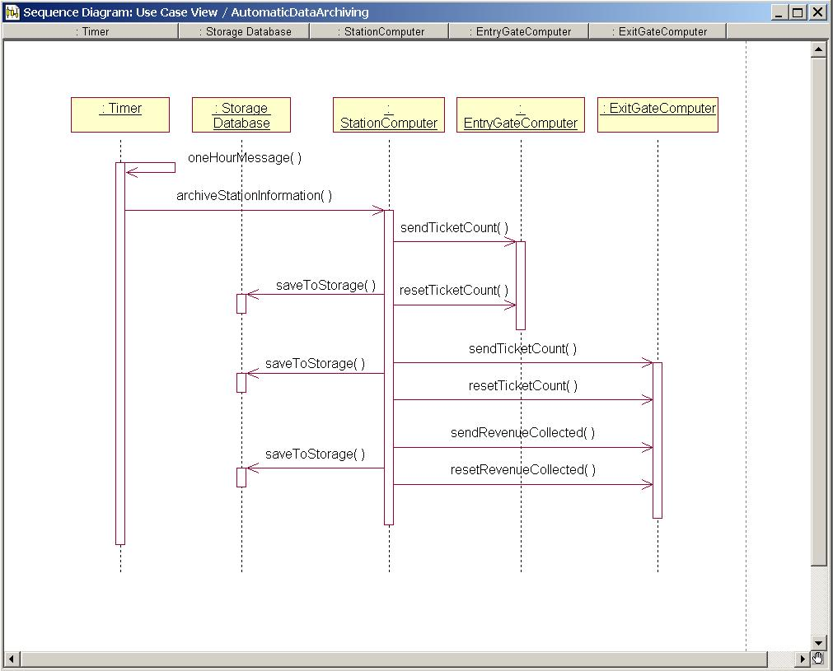
1. Review
the sequence diagram (interaction diagram)
shows the time ordering of messages exchanged by objects – specifies the messages sent and received by objects

Slide 16
1. Review
the sequence diagram (interaction diagram)
time progresses from the top of a sequence diagram to the bottom
objects involved in the interaction are partitioned into vertical columns
object lifetime information is shown as dashed lines - these are called an object's lifeline
object control is shown as a vertical, narrow rectangle representing an object with the control
messages between objects are shown as horizontal, directed lines – specifies the messages sent and received by objects

Slide 17
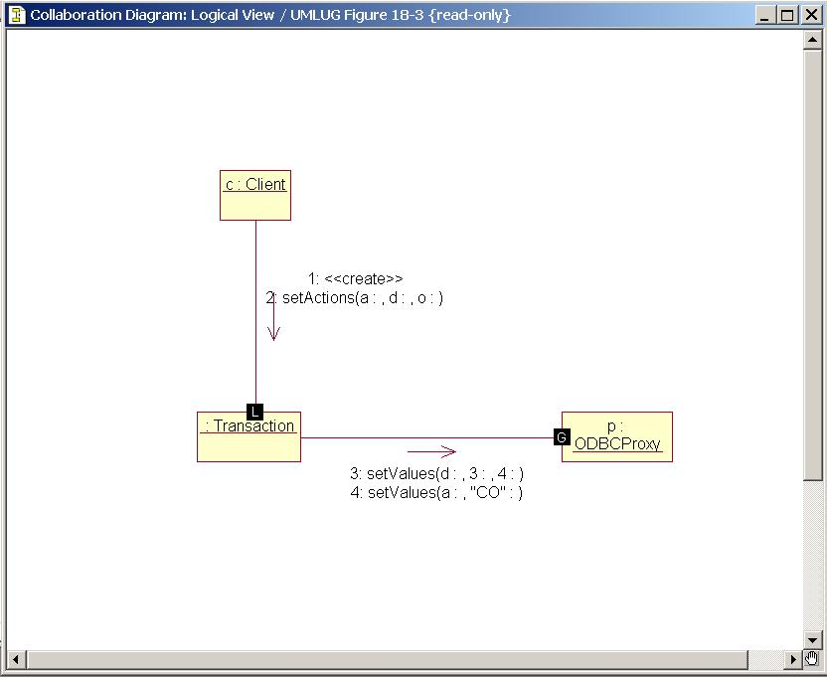
1. Review
the collaboration diagram (interaction diagram)
shows the structural ordering of messages exchanged by objects – specifies the links among objects and the messages that pass over them

Slide 18
1. Review
the collaboration diagram (interaction diagram)
collaboration and sequence diagrams are semantically equivalent
time is not shown explicitly in a collaboration diagram
object lifetime information is not shown as dashed lines
object control is not shown explicitly
messages between objects are shown as labelled, directed arcs beginning with the initiating object and ending on the receiving object
messages are labelled with a number showing the relative order of the message in the sequence of messages

Slide 19
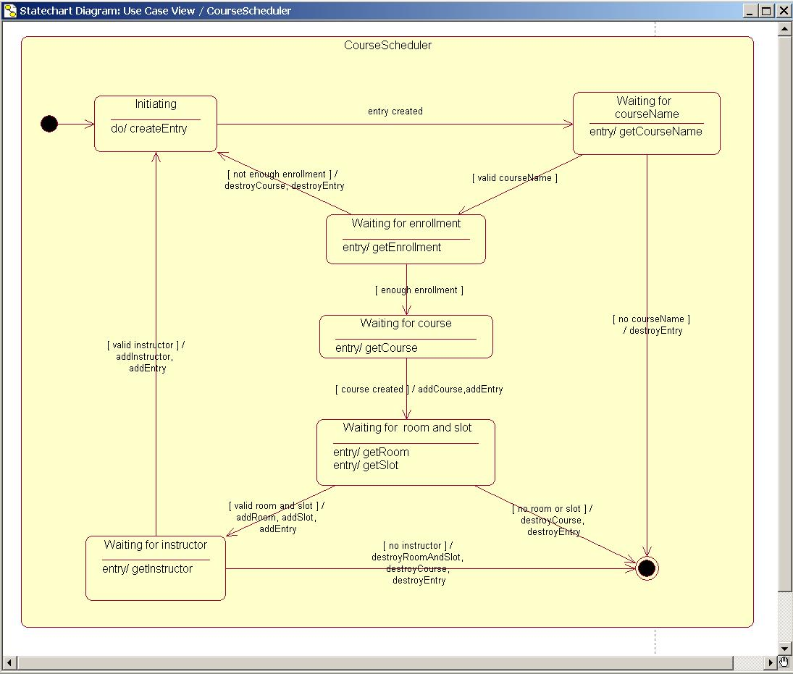
1. Review
the statechart diagram (interaction diagram)
shows a state machine that represents the dynamic behavior of a class – specifies the states, events, transitions, and activities of the class instances

Slide 20
1. Review
the statechart diagram (interaction diagram)
  the representation of a state can have several parts
    name
      a unique text string that identifies the state
    entry/exit actions
    internal transitions
      reaction to events that do not cause a full change of state
    substates
      the structure of a state used in internal transitions
    deferred events
      events deferred to another state of the object

Slide 21
1. Review
the statechart diagram (interaction diagram)
    initial states are represented by a black-filled circle
    final states are represented by a black-filled circle within a circle
  a state transition has five parts
    source state
    event trigger
      signal
      call
      time expiration
      state change
    guard condition evaluated after the event trigger occurs

Slide 22
1. Review
the statechart diagram (interaction diagram)
    action - an executable atomic computation that occurs after transition...it may inlude
      operation calls
      creation/destruction of another object
      sending a signal
    target state

Slide 23
1. Review
the statechart diagram (interaction diagram)
  complex states
    entry action - actions done on entering the state
    exit action - actions are done on leaving the state
    internal transition - transitions used when you do not want the entry/exit actions to be performed
    activity - takes finite time and occurs when in a state...in an activity, you can specify
        an action, another state machine, or a sequence of actions
    deferred events - events received during execution that must be saved until execution is done

Slide 24
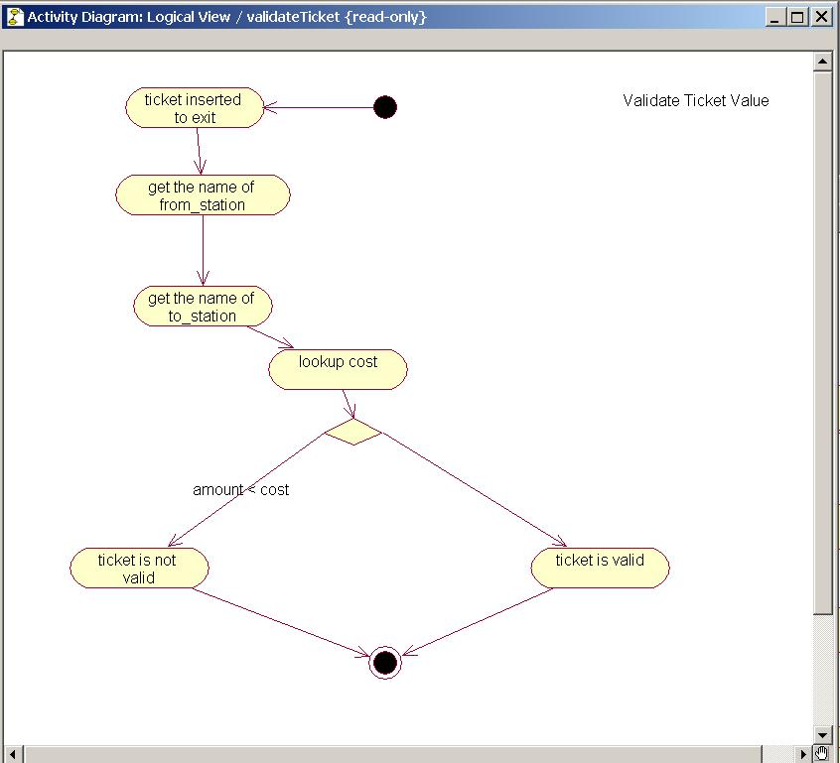
1. Review
the activity diagram
shows the flow of activities within a system
illustrate the sequential and branching flow of activity and the objects that act and are acted on

Slide 25
2. Discussion
Object Diagram Testing Objectives
Are system snapshots permissible configurations?
Need to test:
snapshot objects and links permitted under UML specs
permissible number of links
permissible navigability and visibility
Are system evolutions permissible sequences of object diagrams?
Need to test:
sequence of snapshots is permissible

Slide 26
2. Discussion
Object Diagram Testing Methods
Are system snapshots permissible configurations?
How to establish the snapshot for testing? (no UML spec)
How to test existence of objects and links?
test preparation: automatible from Object Diagram
test measurement: runtime analysis (object internals?)
How to test link numbers and navigability?
test preparation: automatible from Class Diagram
test measurement: runtime analysis (object internals?)
Are system evolutions permissible sequences of object diagrams?
How to establish sequence of system states? (no UML specs)

Slide 27
2. Discussion
Class Diagram Testing Objectives
Are system classes permissible?
Need to test:
existence of classes in libraries
Are system class generalizations/specializations permissible?
Need to test:
determination of class superclasses and subclasses
Are system class aggregations/compositions permissible?
Need to test:
determine object part-of links
determine necessity of part-of links
permissible number of links

Slide 28
2. Discussion
Class Diagram Testing Objectives
Are system class associations permissible?
Need to test:
determine class associations
permissible association mulitplicity
permissible navigability and visibility
Are system class interfaces permissible?
Need to test:
determine class interfaces
correctness of interfaces

Slide 29
2. Discussion
Class Diagram Testing Methods
Are system classes permissible?
How to determine existence of classes in libraries
test preparation: automatible from Class Diagram
test measurement: library analysis (utility classes?)
Are system class generalizations/specializations permissible?
How to determination of class superclasses and subclasses
test preparation: automatible from Class Diagram
test measurement: library/runtime (super()?)

Slide 30
2. Discussion
Class Diagram Testing Methods
Are system class aggregations/compositions permissible?
How to determine object part-of links
test preparation: automatible from Class Diagram
test measurement: library/runtime (method analysis?)
How to determine necessity of part-of links
test preparation: automatible from Class Diagram
test measurement: library/runtime (constructor analysis?)
How to determine permissible number of links
test preparation: automatible from Class Diagram
test measurement: library/runtime (attribute analysis?)

Slide 31
2. Discussion
Class Diagram Testing Methods
Are system class associations permissible?
How to determine class associations?
test preparation: automatible from Class Diagram
test measurement: library/runtime (attribute analysis?)
How to determine association mulitplicity
test preparation: automatible from Class Diagram
test measurement: library/runtime (attribute analysis?)
How to determine navigability and visibility
test preparation: automatible from Class Diagram
test measurement: library/runtime (attribute analysis?)

Slide 32
2. Discussion
Class Diagram Testing Methods
Are system class interfaces permissible?
How to determine class interfaces
test preparation: automatible from Class Diagram
test measurement: library/runtime (realizes analysis?)
How to determine correctness of interfaces
test preparation: automatible from Class Diagram
test measurement: library/runtime (method analysis?)

Slide 33
2. Discussion
Use Case Diagram Testing Objectives
Are system functions available?
Need to test:
system functionality
Use Case Diagram Testing Methods
Are system functions available?
How to determine large-scale functionality
test preparation: large-scale functions automatible from Use Case Diagram
test measurement: black box tests from scenarios by actors following scripts

Slide 34
2. Discussion
Sequence Diagram Testing Objectives
Are message sequences/object interactions correct?
Need to test:
sequences of messages among objects
object participation in interactions
object lifetimes
object control?

Slide 35
2. Discussion
Sequence Diagram Testing Methods
Are message sequences/object interactions correct?
How to determine sequences of messages among objects
test preparation: automatible from Sequence Diagrams
test measurement: unit tests - instrumentation/logs?
How to determine object participation in interactions
test preparation: automatible from Sequence Diagrams
test measurement: unit tests - instrumentation/logs
How to determine object lifetimes/object control
test preparation: automatible from Sequence Diagrams
test measurement: unit tests - instrumentation/logs

Slide 36
2. Discussion
Statechart Diagram Testing Objectives
Are state sequences correct?
Need to test:
event reception and state change
object actions/activities

Slide 37
2. Discussion
Statechart Diagram Testing Methods
Is event reception/state change correct?
How to determine event reception/state change
test preparation: automatible from Statechart Diagrams; how to establish event environment?
test measurement: unit tests - instrumentation/logs?
How to determine object actions/activities
test preparation: automatible from Statechart Diagrams; how to establish event environment?
test measurement: unit tests - instrumentation/logs

Slide 38
2. Discussion
Activity Diagram Testing Objectives
Is system activity flow correct?
Need to test:
system activities → object attributes/actions?
object attributes/actions
Activity Diagram Testing Methods
Are object attributes/actions correct?
How to determine object attributes/actions
test preparation: automatible from Activity Diagrams; how to establish system flow environment?
test measurement: system tests - instrumentation/logs?

Slide 39
2. Discussion
Activity Diagram Testing Methods
Are object attributes/actions correct?
How to determine object attributes/actions
test preparation: automatible from Activity Diagrams; how to establish system flow environment?
test measurement: system tests - instrumentation/logs?

Slide 40
3. Survey
Colorado State (Robert France)
  test generation from class, collaboration,state
AGEDIS Project, IBM Haifa
  test engine/generation from object, class, state
UCTSystem (Nebut)
  use case test generation
Siemens (Hartmann)
  functional testing (equivalence classes)

Slide 41
3. Survey
COTE (Umlaut/TGV)
  test generation from class, collaboration,state
Rhapsody ATG (Germany)
  UML and source code

